Slide 1

NLP use cases: (i) King’s Health Partners (ii) The Maudsley CRIS dataset and NLP service

Slide 2
Examples from King’s Health Partners

Slide 3
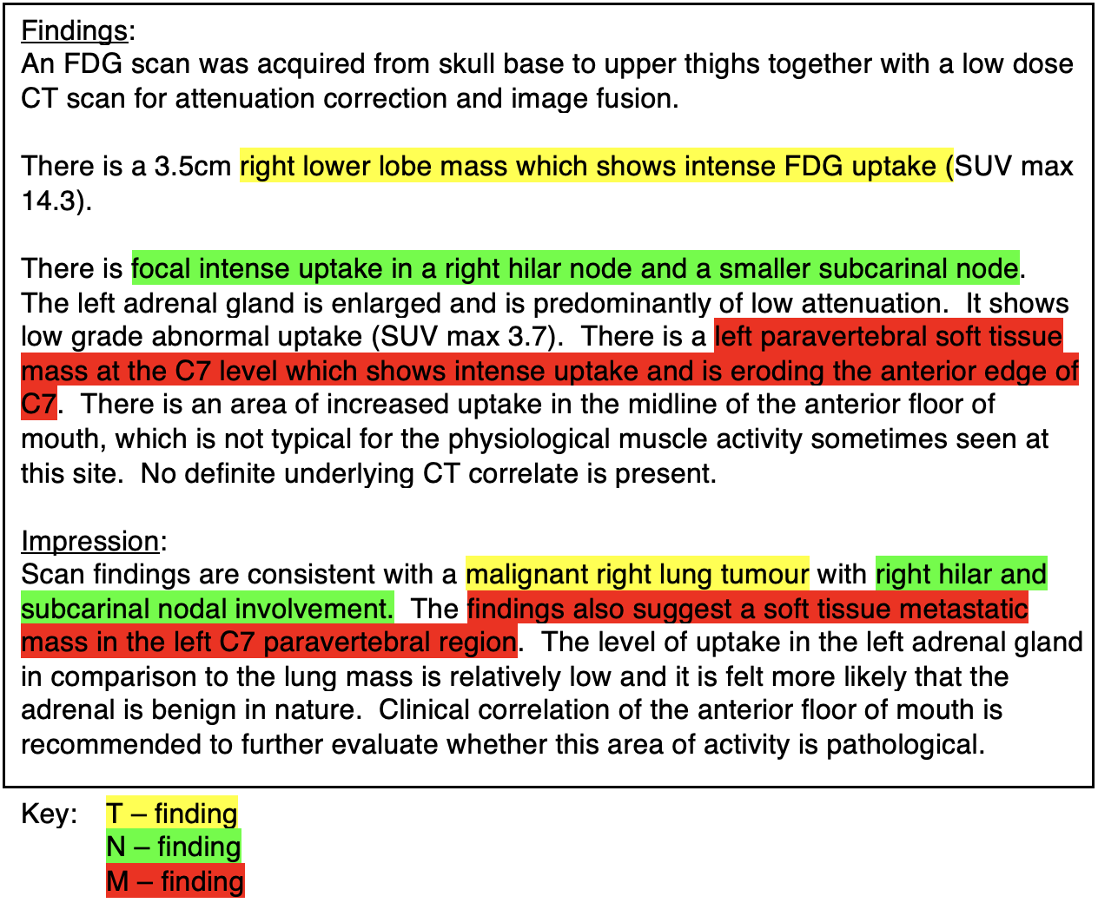
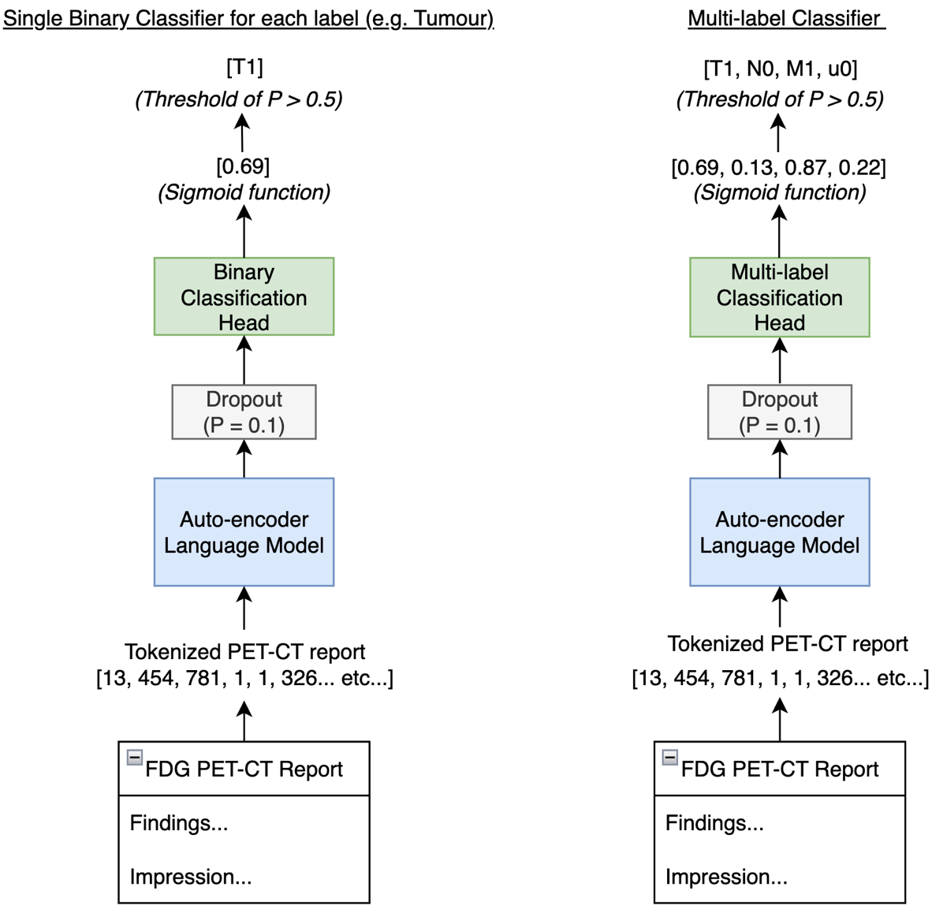




TNM staging in PET-CT reports for lung cancer
Stephen Barlow, Sugama Chicklore, Yulan He, Thomas Wagner, Anna Barnes, Gary Cook

Slide 4
TNM staging in PET-CT reports for lung cancer
PLM | Training Corpora Focus | Parameters | ACC_{TNMu} ↑ | HL_{TNMu} ↓ | F1_{T} ↑ | F1_{N} ↑ | F1_{M} ↑ | F1_{u} ↑
BERT (Base) | General | 110m | 0.63 ± 0.03 | 0.13 ± 0.01 | 0.78 ± 0.04 | 0.91 ± 0.02 | 0.80 ± 0.02 | 0.46 ± 0.00
BERT (Large) | General | 340m | 0.67 ± 0.02 | 0.12 ± 0.01 | 0.83 ± 0.03 | 0.91 ± 0.01 | 0.81 ± 0.01 | 0.53 ± 0.08
RoBERTa (Base) | General | 125m | 0.69 ± 0.03 | 0.10 ± 0.01 | 0.83 ± 0.02 | 0.93 ± 0.01 | 0.84 ± 0.01 | 0.56 ± 0.08
RoBERTa (Large) | General | 355m | 0.77 ± 0.01 | 0.08 ± 0.01 | 0.91 ± 0.01 | 0.93 ± 0.01 | 0.87 ± 0.02 | 0.74 ± 0.01
BioBERT (Base) | Biomedical | 110m | 0.70 ± 0.01 | 0.10 ± 0.00 | 0.85 ± 0.01 | 0.92 ± 0.01 | 0.85 ± 0.01 | 0.50 ± 0.02
BioBERT (Large) | Biomedical | 340m | 0.75 ± 0.02 | 0.09 ± 0.01 | 0.91 ± 0.02 | 0.93 ± 0.01 | 0.86 ± 0.02 | 0.70 ± 0.02
BioMegatron | Biomedical | 345m | 0.76 ± 0.02 | 0.08 ± 0.01 | 0.90 ± 0.01 | 0.95 ± 0.01 | 0.85 ± 0.01 | 0.73 ± 0.00
BioClinicalBERT | Clinical | 110m | 0.66 ± 0.01 | 0.12 ± 0.00 | 0.81 ± 0.03 | 0.90 ± 0.01 | 0.78 ± 0.03 | 0.46 ± 0.00
RadBERT | Clinical | 110m | 0.62 ± 0.01 | 0.13 ± 0.01 | 0.78 ± 0.02 | 0.88 ± 0.03 | 0.79 ± 0.03 | 0.46 ± 0.00
RadBERT-RoBERTa-4m | Clinical | 125m | 0.71 ± 0.01 | 0.10 ± 0.01 | 0.88 ± 0.02 | 0.93 ± 0.01 | 0.84 ± 0.01 | 0.59 ± 0.02
GatorTron (Base) | Clinical | 345m | 0.84 ± 0.01 | 0.06 ± 0.01 | 0.96 ± 0.01 | 0.96 ± 0.00 | 0.90 ± 0.01 | 0.81 ± 0.01

Slide 5
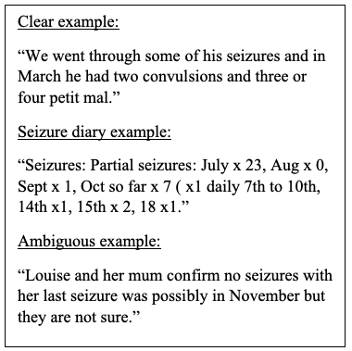
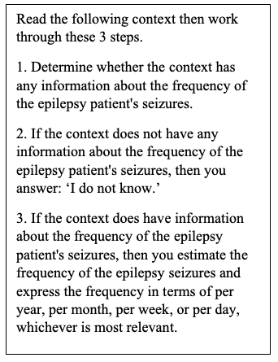



Seizure frequency extraction from medical records
Ben Holgate, Shichao Fang, Mark Richardson
Model prompted to be a
“professional neuroscientist who is responding to fellow neuroscientists” and to give “succinct answers”.
Provided with 11 examples

Slide 6
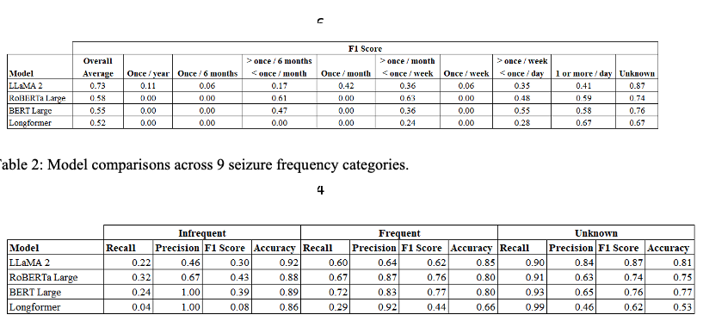
Seizure frequency extraction from medical records
Ben Holgate, Shichao Fang, Mark Richardson
Performance across 9 categories
Llama 2 trained on 11 examples.
Other models trained on approx. 1400 examples.
Performance across 3 categories

Slide 7


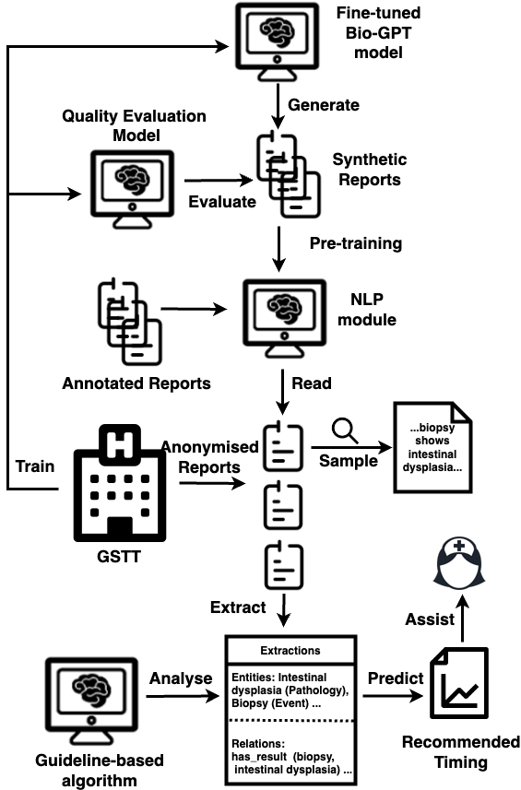

Extracting information for Barrett’s surveillance
Leo Zhang, Sebastian Zeki, Angus Roberts
Endoscopy and pathology reports
… biopsies demonstrate low grade dysplasia …
Entity and relation
extraction
entity
entity
has_location

Slide 8
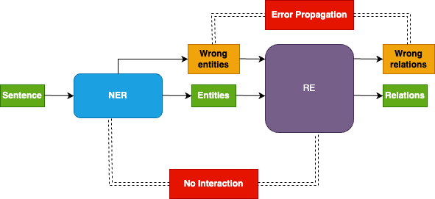
Entity and relation extraction
Leo Zhang, Sebastian Zeki, Angus Roberts
Traditional Pipeline model:
Joint training model:
Entity extraction
Relation
extraction
Entities
Relations

Slide 9
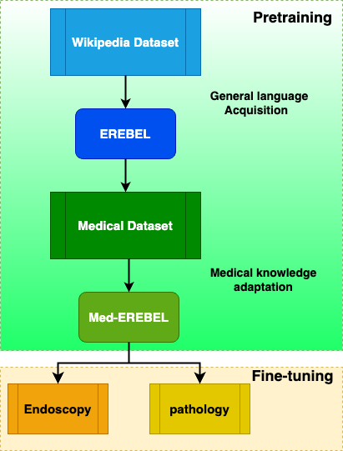
Joint entity and relation extraction (E-REBEL):
Leo Zhang, Sebastian Zeki, Angus Roberts
Initial results (no medical adaptation)
 | P | R | F1 | Support
Entities | 87 | 87 | 86 | 3235
Relations | 63 | 58 | 61 | 1266
Cost of labelling and training
Do we need to extract fine-grained detail?
Might it help with explainabllity?

Slide 10
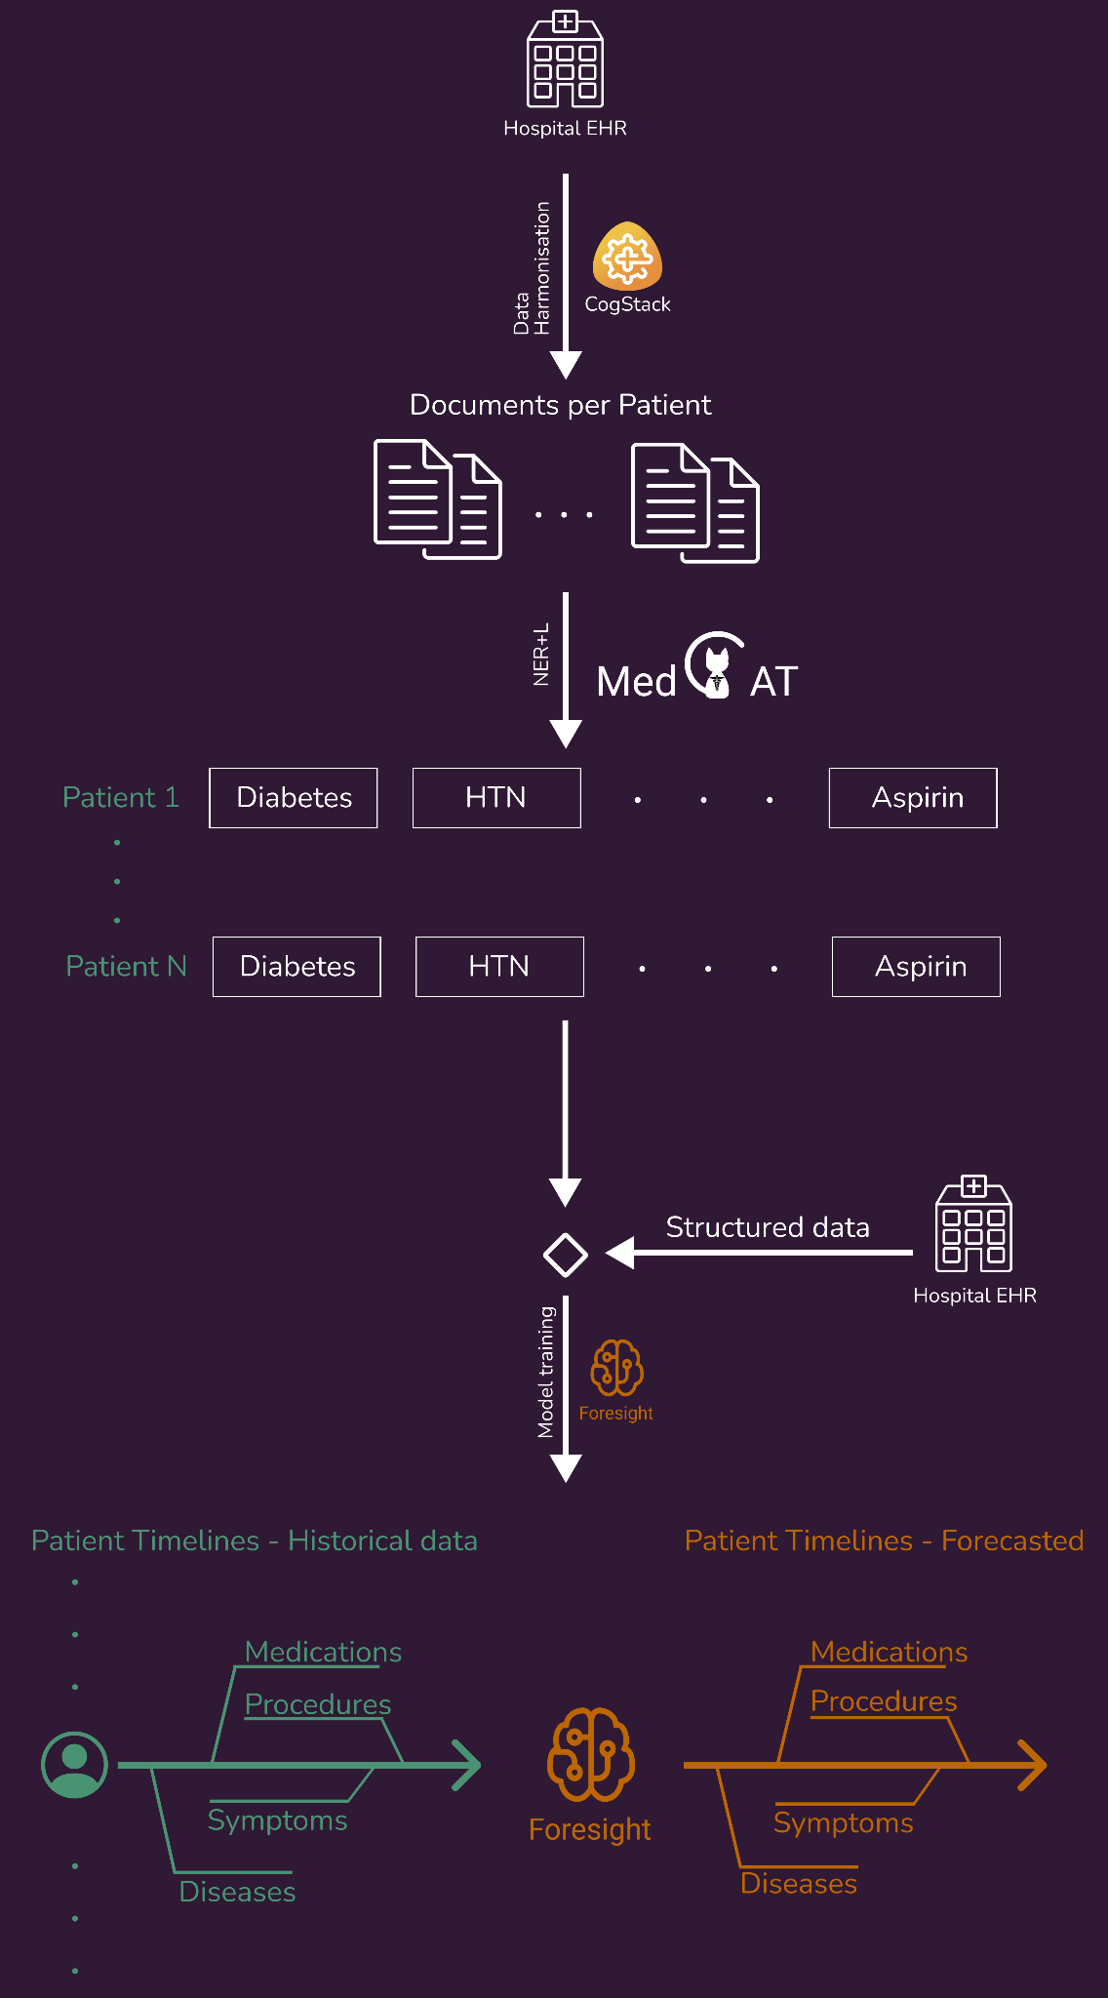
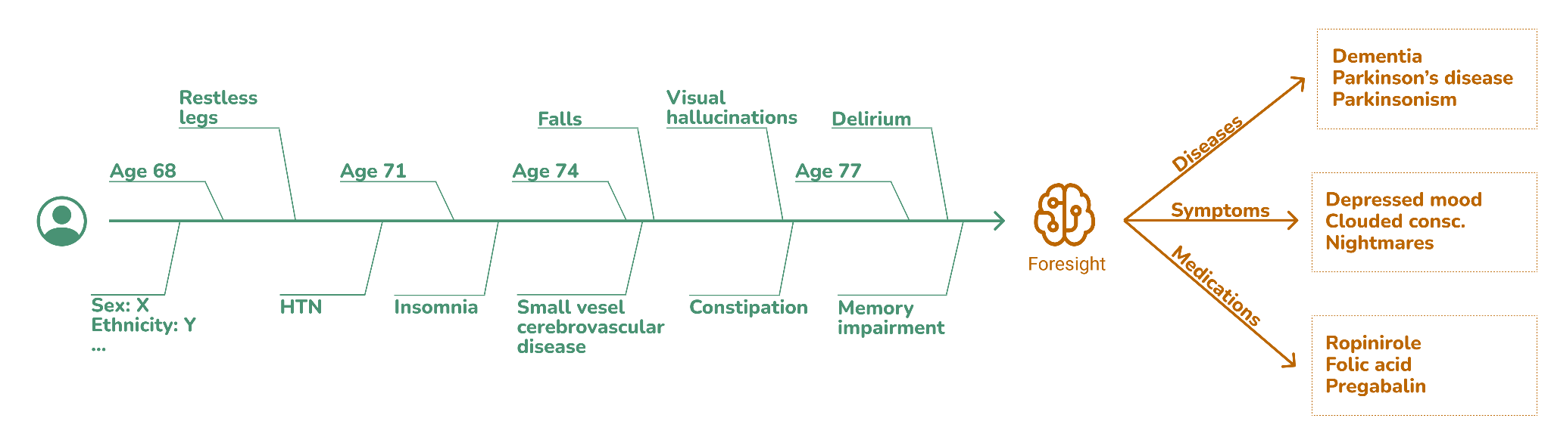
Foresight
Zeljko Kraljevic
 | KCH (Precision) |  | SLaM (Precision)
 | TOP-1 | TOP-10 | TOP-1 | TOP-10
Precision Overall | 0.667 | 0.917 | 0.658 | 0.938
Precision Disorders | 0.605 | 0.874 | 0.637 | 0.917
Precision Substances | 0.716 | 0.950 | 0.731 | 0.958
Demo and Paper: https://foresight.sites.er.kcl.ac.uk/
Notes:
190k concepts

Slide 11
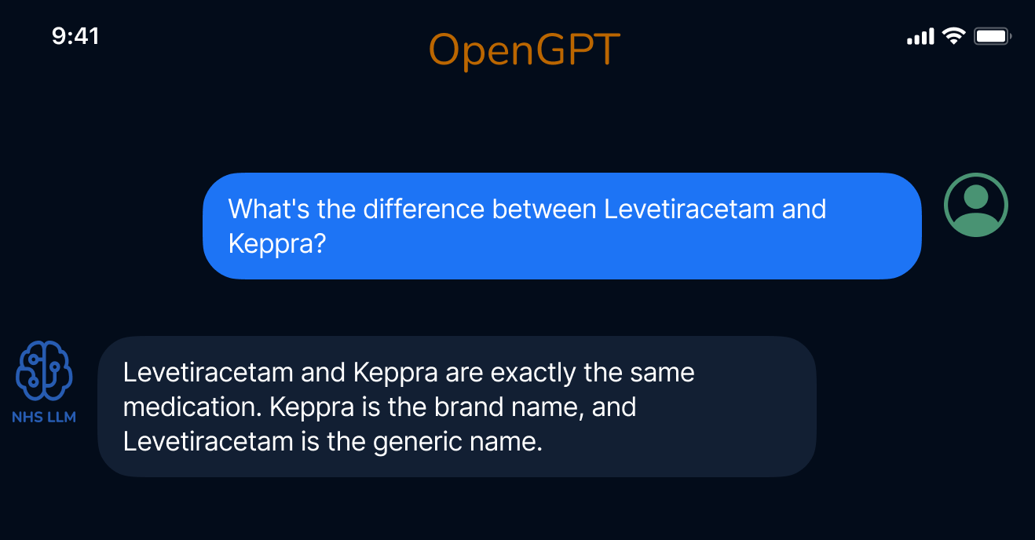
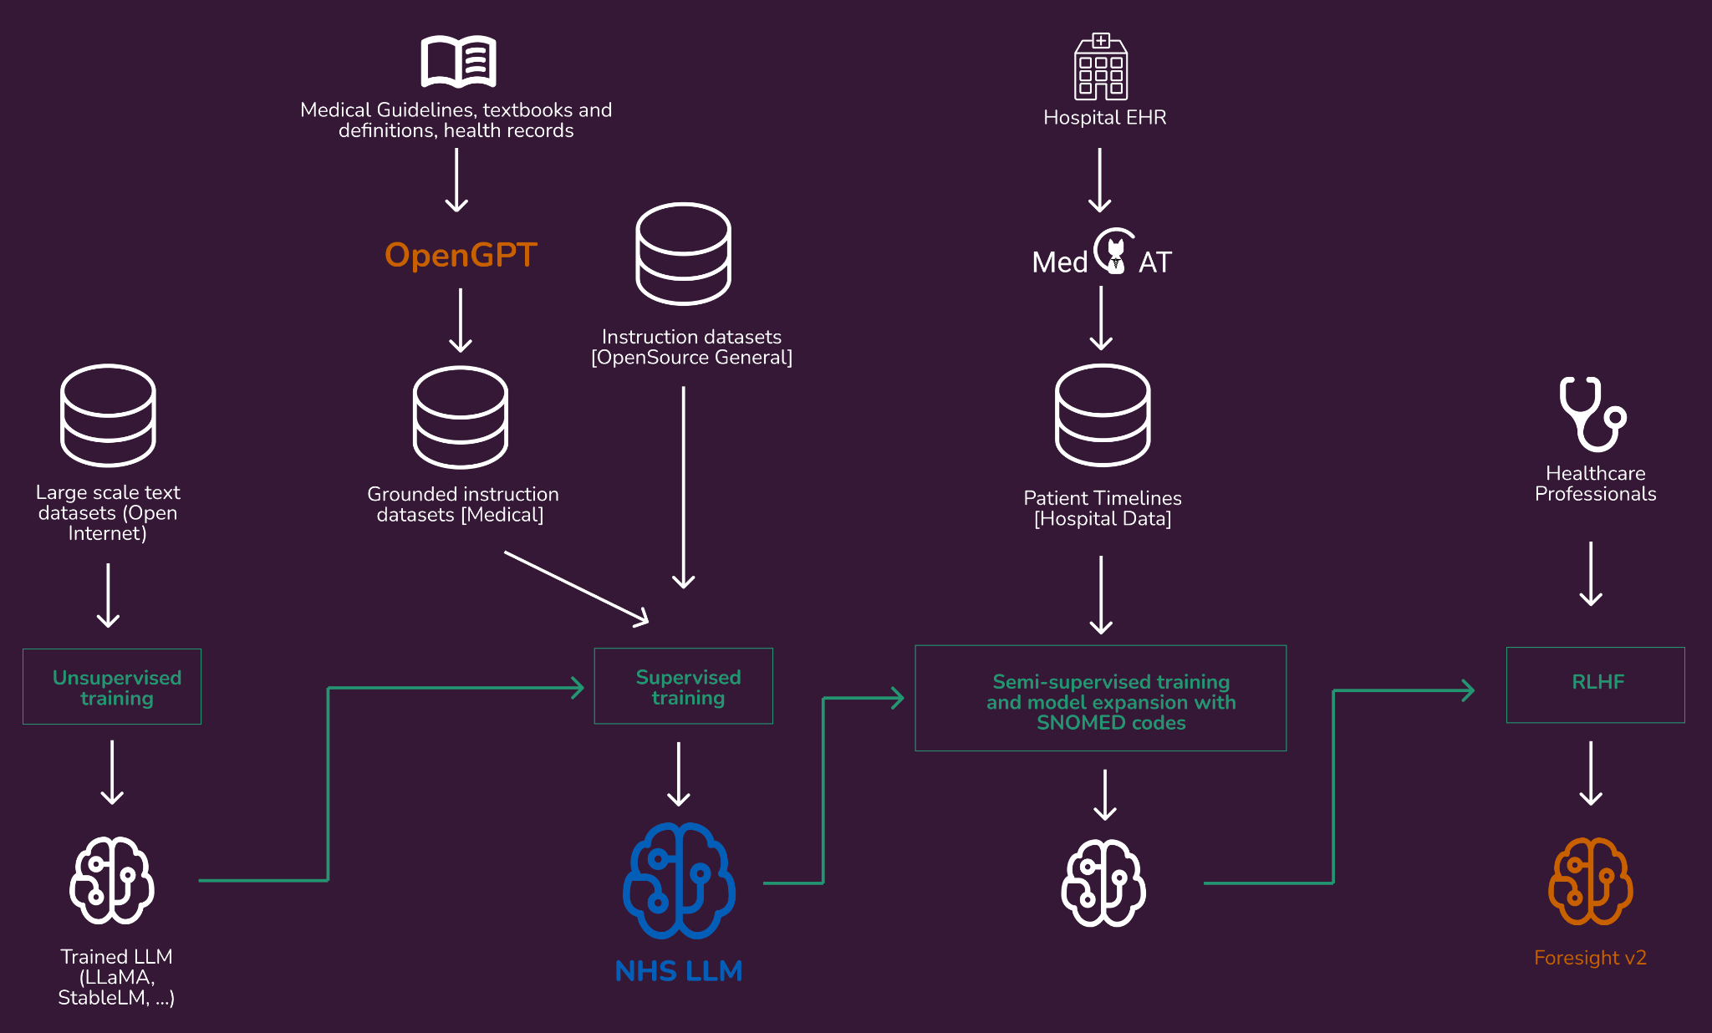
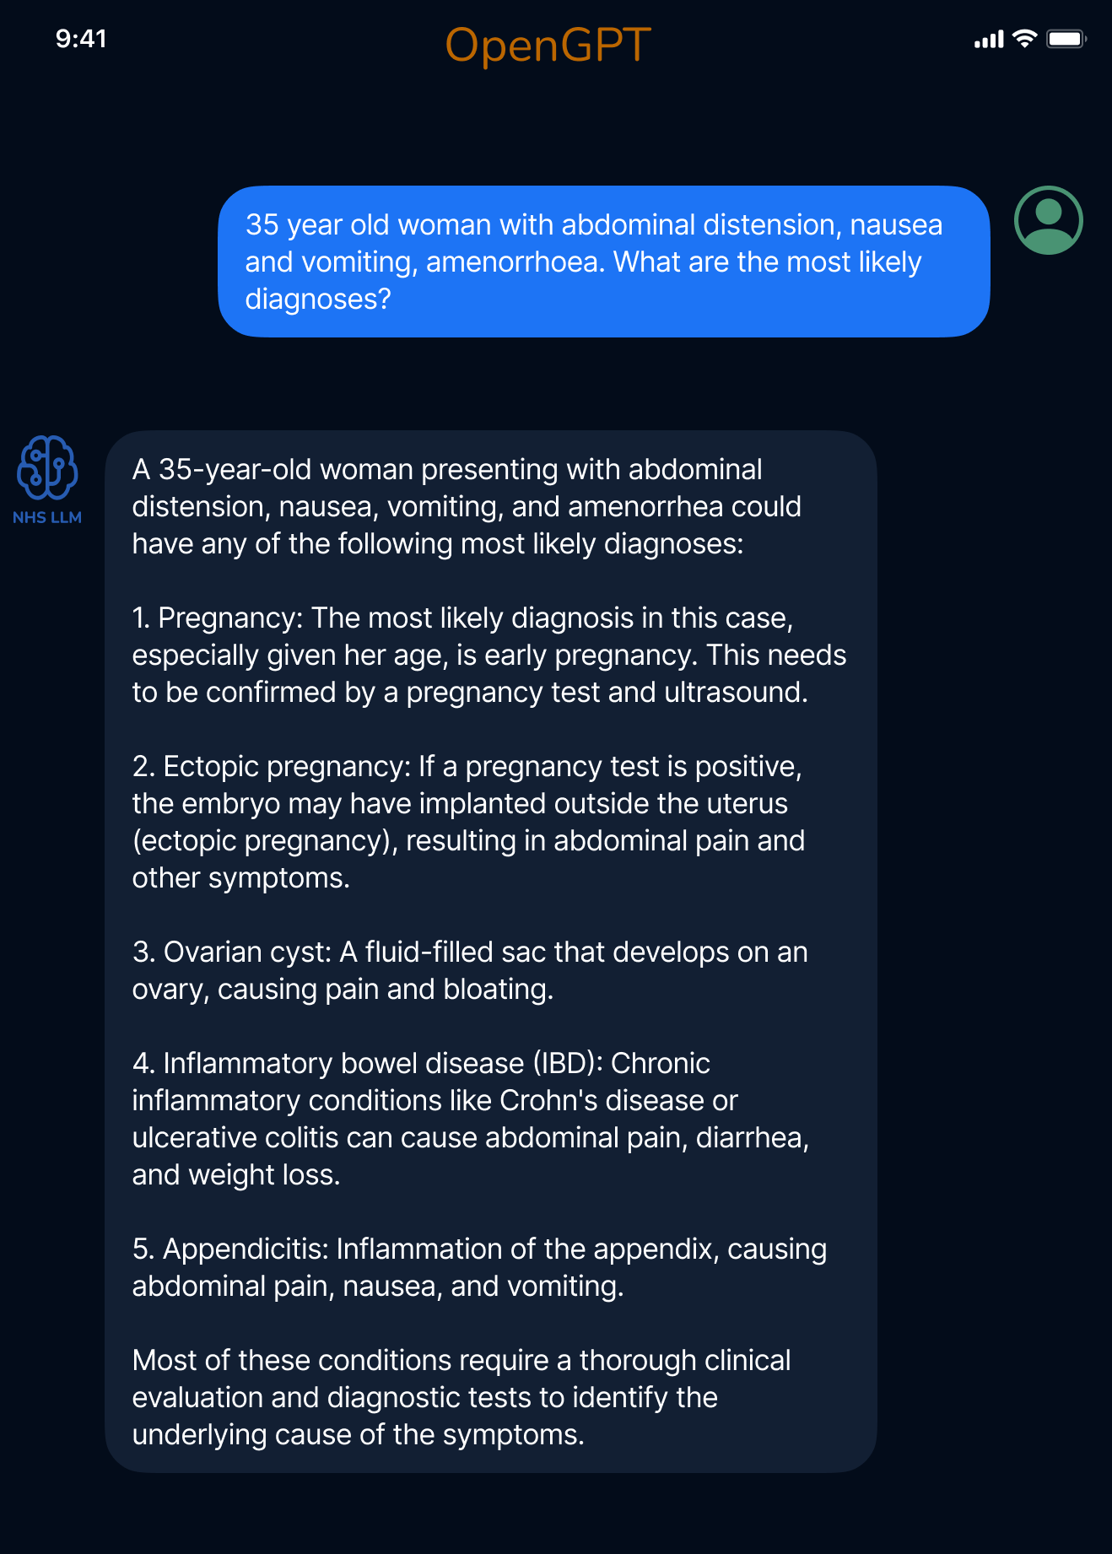
Foresight
Zeljko Kraljevic
https://aiforhealthcare.substack.com/p/a-large-language-model-for-healthcare

Slide 12
Examples from the Maudsley BRC

Slide 13
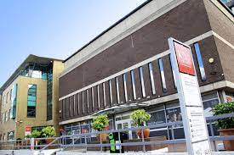
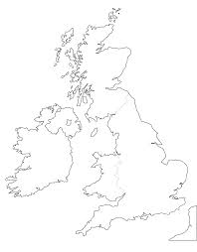
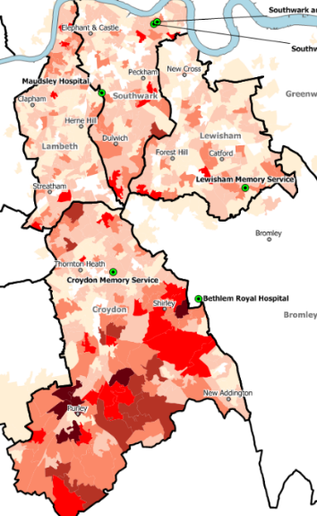
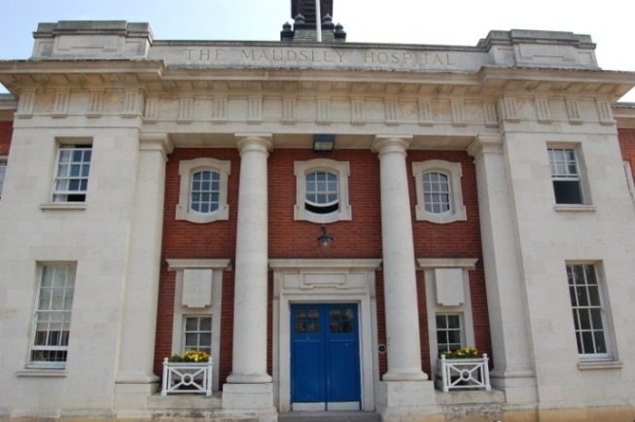
The Maudsley Biomedical Research Centre (BRC)
King’s College London (KCL)
SLaM service provision
All aspects of specialist mental health care
.
Southwark
South London and Maudsley (SLaM)
Lambeth
Defined catchment
Lewisham
Croydon
1.36 million residents
Southwark, Lambeth, Lewisham, & Croydon
Complete EHRs since 2007

Slide 14

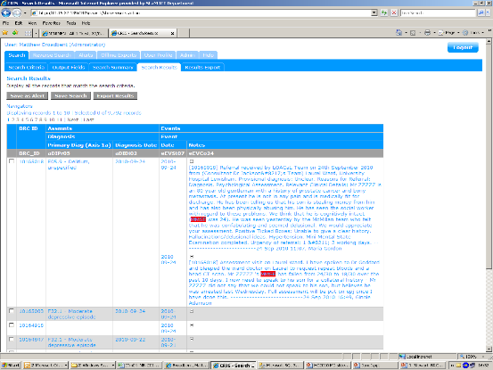
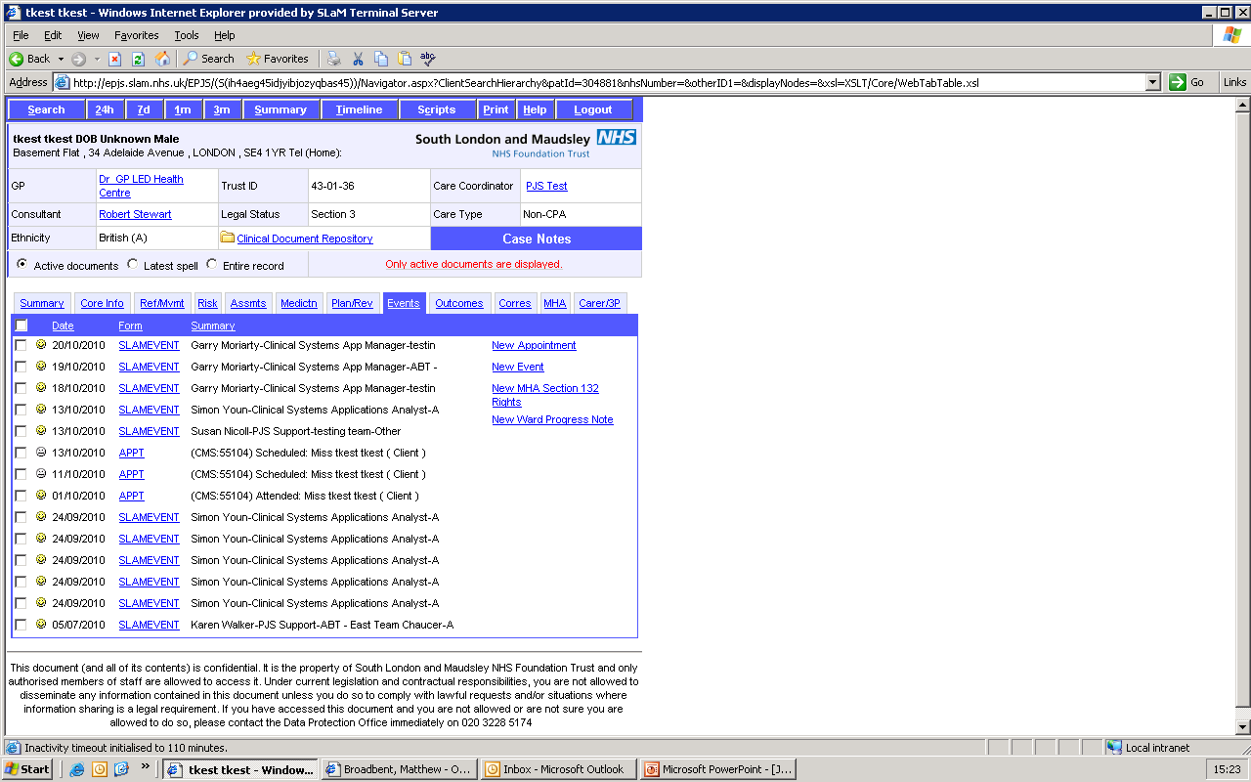
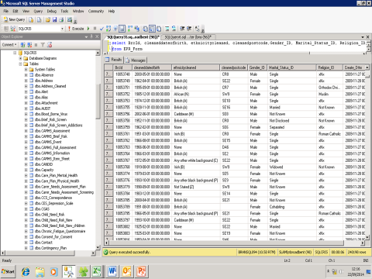
The CRIS dataset and service
Researcher self-service
CRIS front end
EHR
Data Source
De-identification
Processing pipeline
CRIS analyst service
>400,000 cases
35,000 ‘active’ cases
125 tables
6500 fields
30m documents
CRIS SQL
Set up in 2007-08 (NIHR funding)
Re-build and enhancement in 2017
Exported successfully to other UK Trusts
>300 research papers to date

Slide 15

Data access: user led governance
Research ethics approval 2008, 2013, 2018
Numerous amendments for data linkages
CRIS users
Require a trust contract or research passport
Source EHR
De-identification, including free text
Audit log of all CRIS use
Project application
CRIS
Project approval process
Record level Output
Trust firewall
CRIS security model developed and managed by stakeholder / patient-led oversight committee
Findings

Slide 16
The CRIS dataset and service
Researcher self-service
CRIS front end
EHR
Data Source
Limited data:
demographics
diagnosis
service dates
mandatory outcome scales (HoNOS)
Many other fields incomplete
De-identification
Processing pipeline
CRIS analyst service
>400,000 cases
35,000 ‘active’ cases
125 tables
6500 fields
30m documents
CRIS SQL
Set up in 2007-08 (NIHR funding)
Re-build and enhancement in 2017
Exported successfully to other UK Trusts
>300 research papers to date

Slide 17
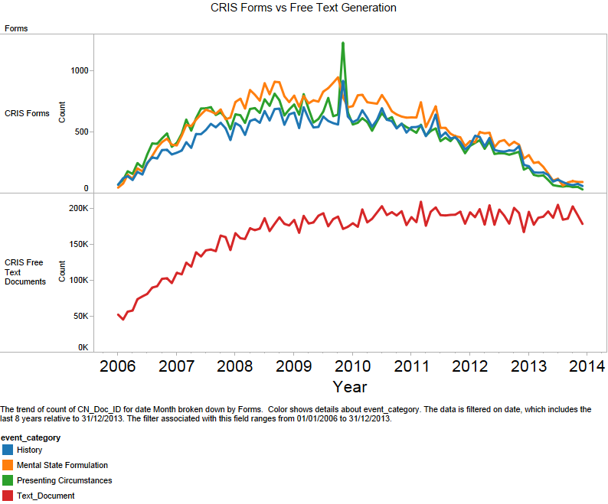
Problem: structured data field use in CRIS

Slide 18
Data expansion 1 - database linkages
Internal linkages
Pharmacy dispensing data
Research databases (e.g. GAP)
Bioresource and imaging
Psychological therapies (IAPT)
Clozapine monitoring
CRIS front end
EHR
Data Source
External linkages
ONS (death certification)
Local Primary Care (LDN)
NHS Digital (HES)
PHE (National Cancer Registry)
Local Acute Care (maternity, neonatal)
DfE/ONS (National Pupil Database)
‘Me and My School’
DWP (benefits receipt)
ONS (UK Census records)
Clinical Data Linkage Service
CRIS SQL
Technical elements (identifiers and matching)
Procedural elements (data flow, documentation)
Underlying governance (REC, HRA CAG – s251)
Rationale (scientific question)
Goodwill, trust and luck
‘Context’ / spatio-temporal
Local environment (SELCoH)
Social media (PHEME)
Geospatial data (pollution)
Temperature/weather

Slide 19
Unstructured data fields in CRIS – a solution?

Slide 20


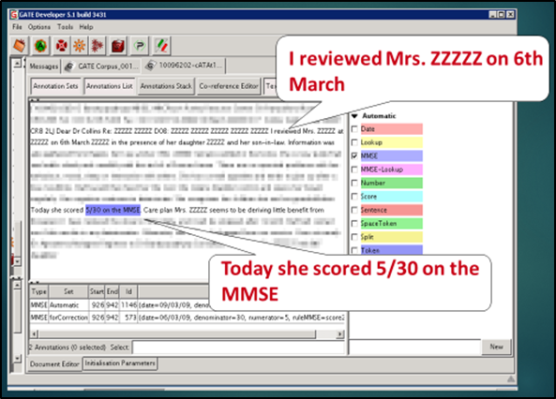
Data expansion 2 – text analytics
CRIS front end
EHR
Data Source
Clinical Data Linkage Service
CRIS SQL
External data

Slide 21
Cohort studies using EHRs – rich textual data
Intervention indications
Intervention
Outcome
Intervention context
Symptoms
Psychosis
Positive
Negative
Disorganisation
Manic
Catatonic
Cognitive
Affective
Depressive
Instability
Anxiety/somatic
Obsessive/compulsive
Behaviour
Agitation/withdrawal
Other
Insight
Context
Cognitive function
Social care
Living alone
Diagnosis
Occupation
Education
Physical disorders Investigations
Violence/abuse
Life stressors
Substances
Smoking
Alcohol
Cannabis
Mephedrone
Amphetamine
Cocaine
Others
Interventions
Pharmacotherapy
Polypharmacy
Adherence/compliance
Non-response, resistance
Psychotherapy
CBT (receipt, offer, etc.)
DBT
CAT
Family
Outcomes
Adverse drug events
Extrapyramidal
Other
Symptom trajectories
Improvement
Deterioration
General mental health
Improvement
Deterioration
BMI
Blood pressure
HBA1C
Symptoms
Aggression
Agitation
Anergia
Anhedonia
Apathy
Blunted affect
Bradykinesia (dementia)
Circumstantial speech
Delusions
Derailment of speech
Disturbed sleep
Echolalia
Elation
Flight of ideas
Formal thought disorder
Grandiosity
Guilt
Hallucinations (all)
Symptoms
Hallucinations (OTG)
Helplessness
Hopelessness
Hostility
Insomnia
Irritability
Low energy
Low mood
Mini Mental State Examination
Mood instability
Mutism
Negative symptoms
Paranoia
Persecutory ideation
Poor appetite
Poor concentration
Poor insight
Symptoms
Poverty of speech
Poverty of thought
Psychomotor retardation
Rigidity
Social withdrawal
Suicide attempt
Tangential speech
Tearfulness
Thought block
Treatment-resistant depression
Tremor
Waxy flexibility
Worthlessness
https://www.maudsleybrc.nihr.ac.uk/facilities/clinical-record-interactive-search-cris/cris-natural-language-processing/

Slide 22
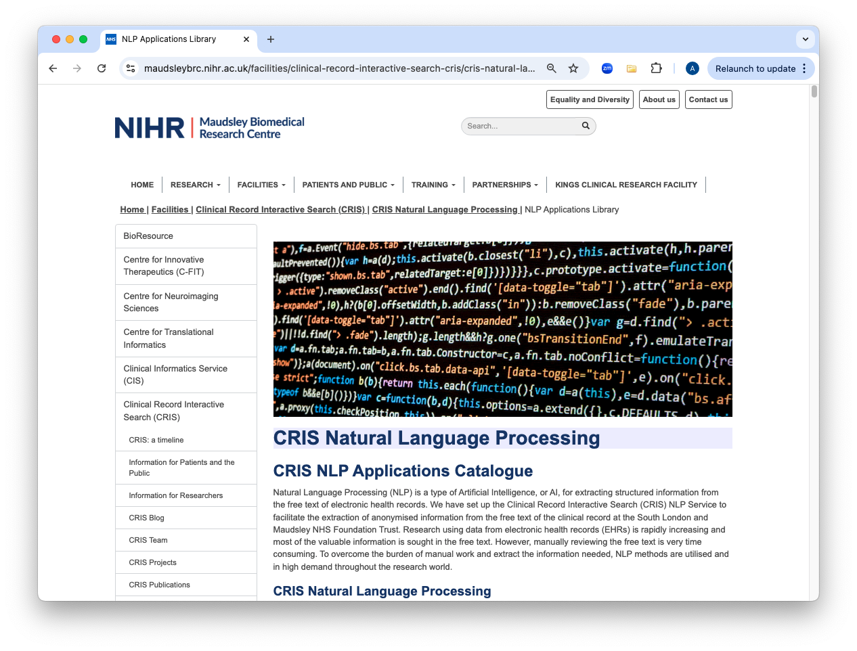
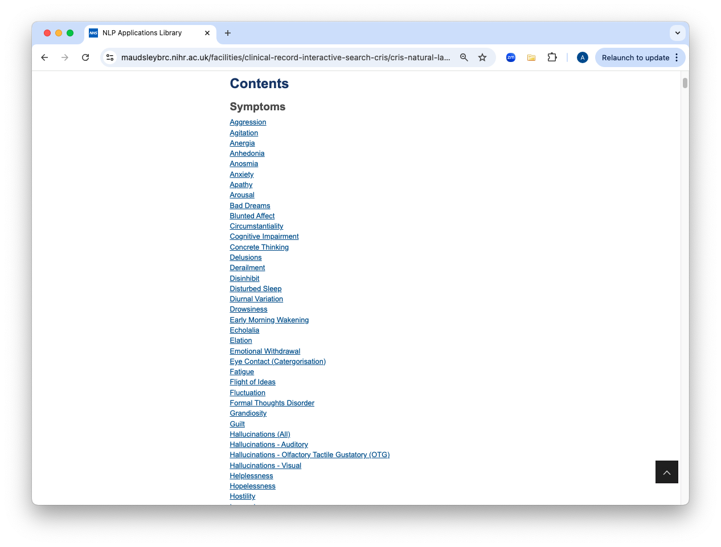
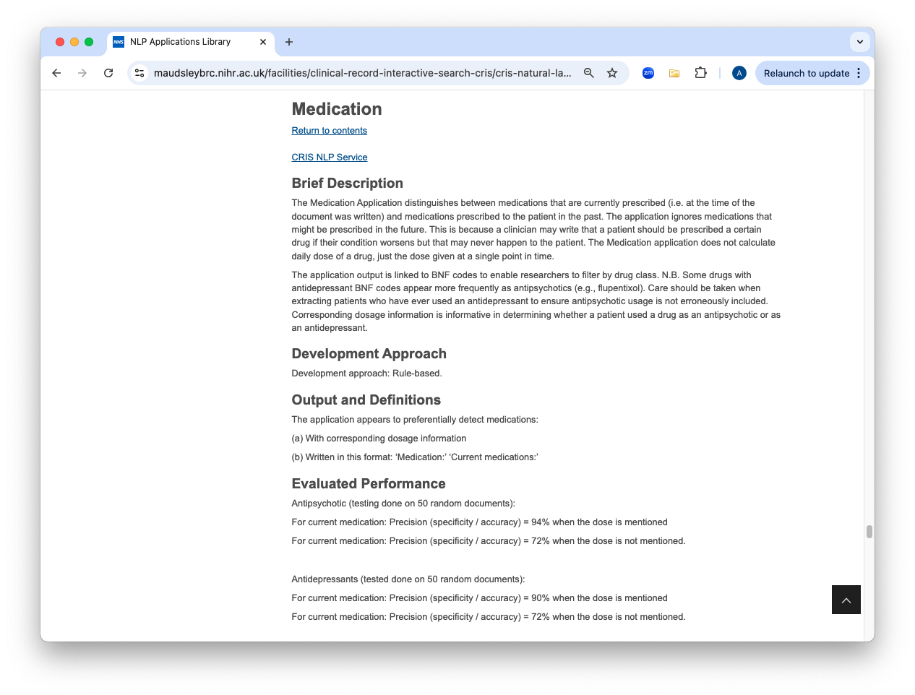
CRIS NLP Applications Catalogue
https://www.maudsleybrc.nihr.ac.uk/facilities/clinical-record-interactive-search-cris/cris-natural-language-processing/nlp-applications-library/

Slide 23
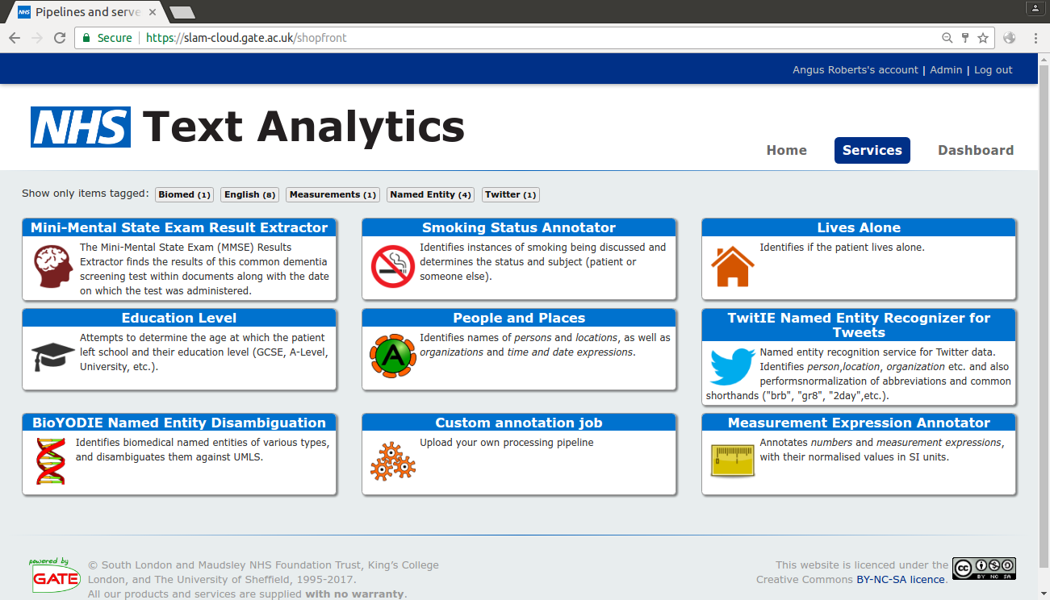


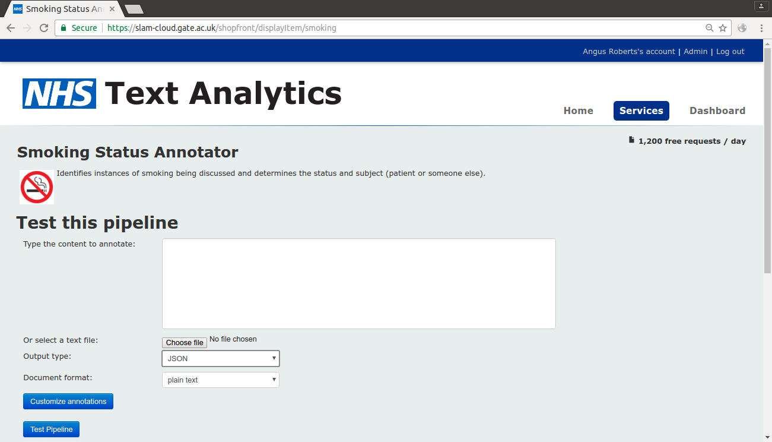
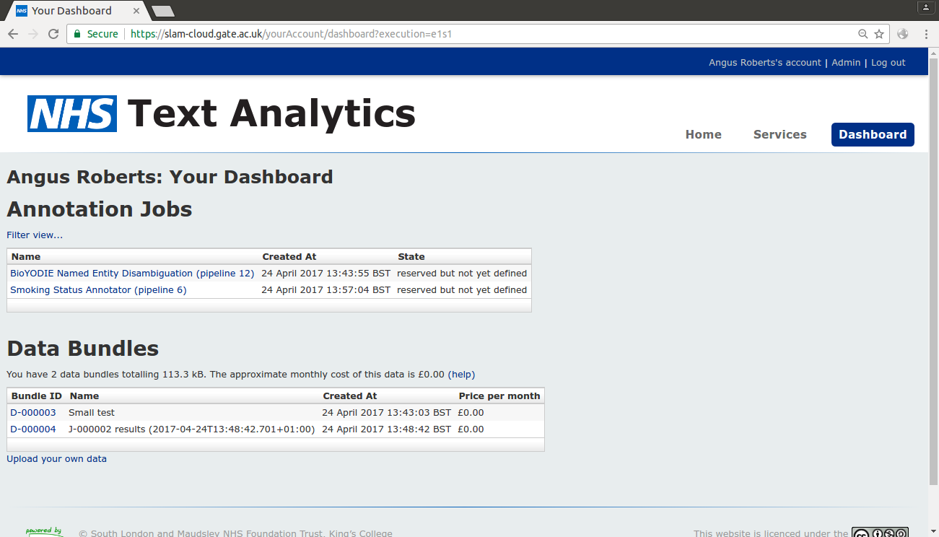
Self-service cloud-based analytics
1. Choose a service
3. Run services on
pre-defined data
bundles
2. Test the service

Slide 24
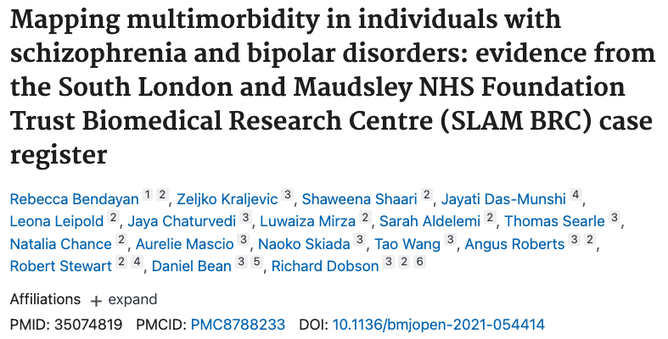
MedCAT - multiomorbidity
Cerebrovascular accident
Epilepsy
Diabetes mellitus
Chronic kidney disease
Psoriasis
Parkinson’s
Multiple sclerosis
Eczema
Hypertensive disorder
Transient ischaemic attacks
Migraine
Chronic obstructive lung disease
Arthritis
Heart failure
Asthma
Ischaemic heart disease
Irritable bowel disease
Atrial fibrillation
Chronic liver disease
Chronic sinusitis
Coronary arteriosclerosis

Slide 25
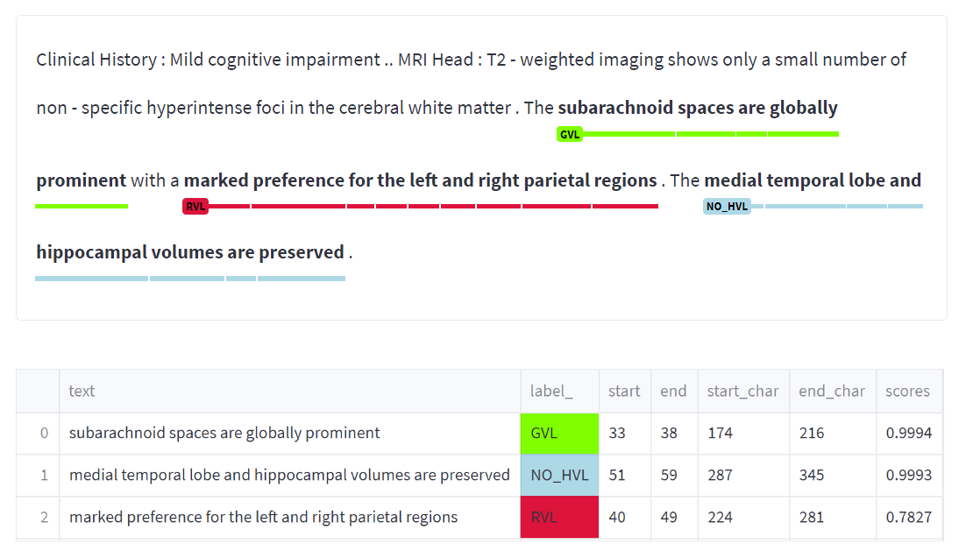
Extracting dementia related volumetric assessments from radiology reports
Adam Mayers
Category | Label
Global Volume Loss – Present | GVL
Global Volume Loss – Absent | NO_GVL
Regional Volume Loss – Present | RVL
Regional Volume Loss – Absent | NO_RVL
Hippocampal/Medial Temporal Lobe Volume Loss – Present | HVL
Hippocampal/Medial Temporal Lobe Volume Loss – Absent | NO_HVL

Slide 26



Extracting dementia related volumetric assessments from radiology reports
Adam Mayers
Category | Precision | Recall | F-Score
Global Volume Loss –Present | 0.95 | 0.95 | 0.95
Global Volume Loss –Absent | 0.94 | 0.77 | 0.85
Regional Volume Loss –Present | 0.80 | 0.58 | 0.68
Regional Volume Loss –Absent | 0.91 | 0.93 | 0.92
Hippocampal Volume Loss –Present | 0.90 | 0.88 | 0.89
Hippocampal Volume Loss –Present | 0.94 | 0.92 | 0.93
Off-the-shelf NLP tools:

Slide 27


Extracting mentions of interpersonal violence
People with mental illness are more likely to experience violent victimisation compared to the general population- 15–45% of female patients report experiences of victimization in the past year, and 40–90% reporting lifetime victimization.
Similar patterns have been observed for domestic violence, sexual violence, violence perpetration, and witnessing violence.
Potential for use in research of electronic health records (EHRs) kept by mental health services

Slide 28
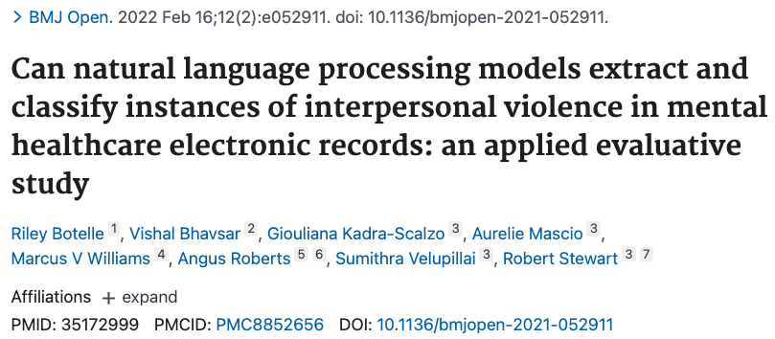
Extracting mentions of interpersonal violence
 | Training set (average score on 10-fold cross-validation) |  |  | Blind test set
Annotation label | Precision | Recall | F1-score | F1-score
Violence presence | 93% | 93% | 93% | 95%
Patient status: Perpetrator | 89% | 89% | 89% | 85%
Patient status: Victim | 91% | 89% | 91% | 90%
Violence type: Domestic | 94% | 94% | 94% | 93%
Violence type: Physical | 91% | 92% | 91% | 98%
Violence type: Sexual | 98% | 97% | 97% | 93%

Slide 29

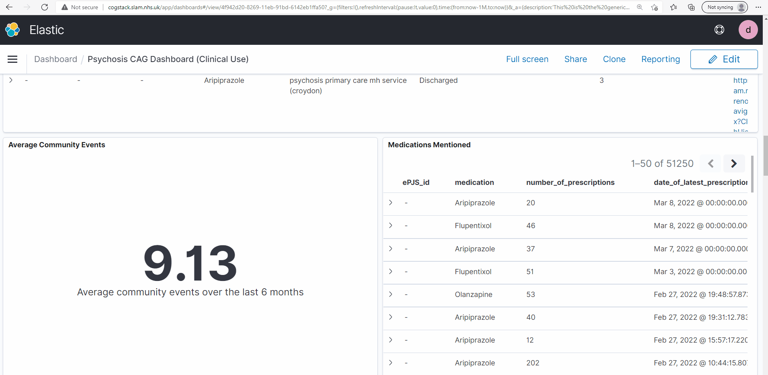
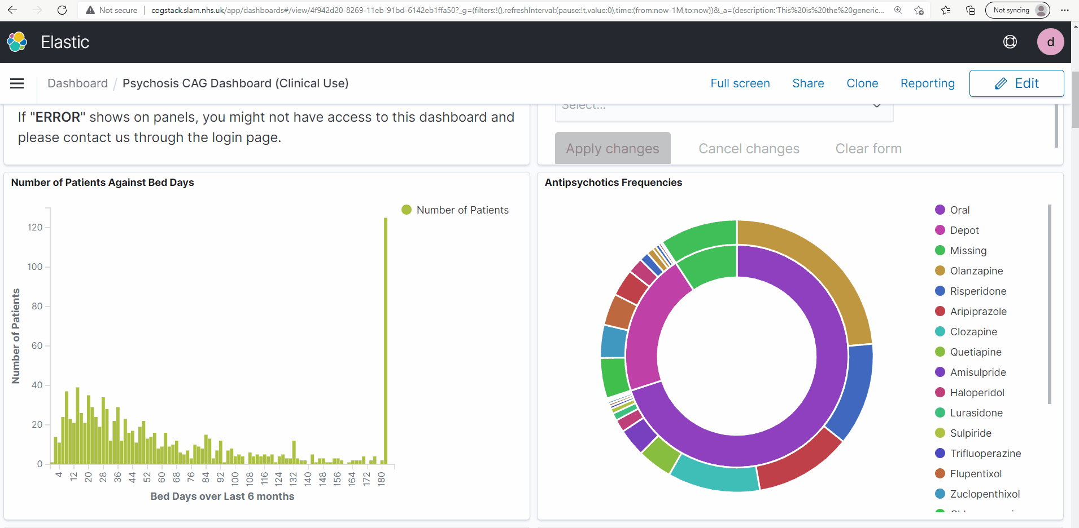
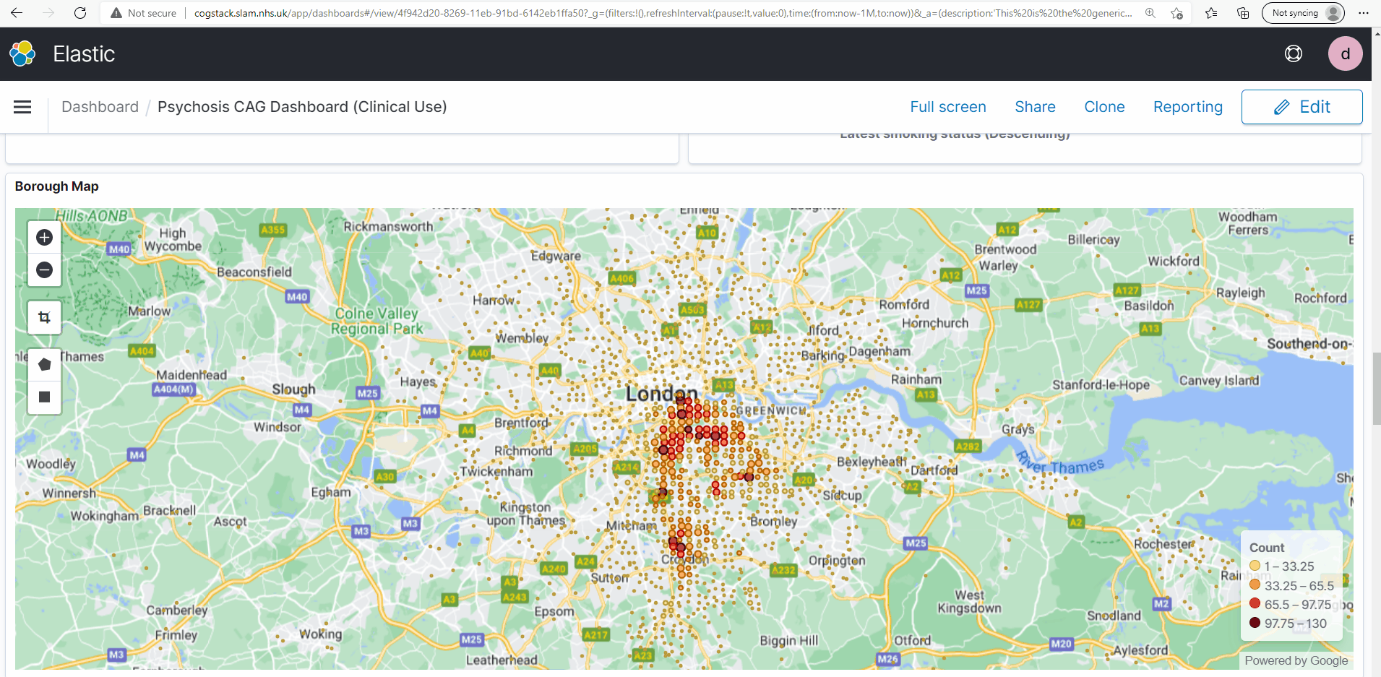
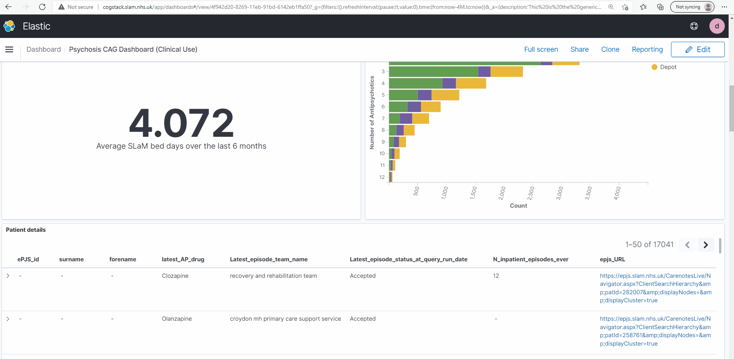
VIEWER – bringing NLP to the clinic
Credit: Tao Wang, Yamiko Msosa, David Codling

Slide 30
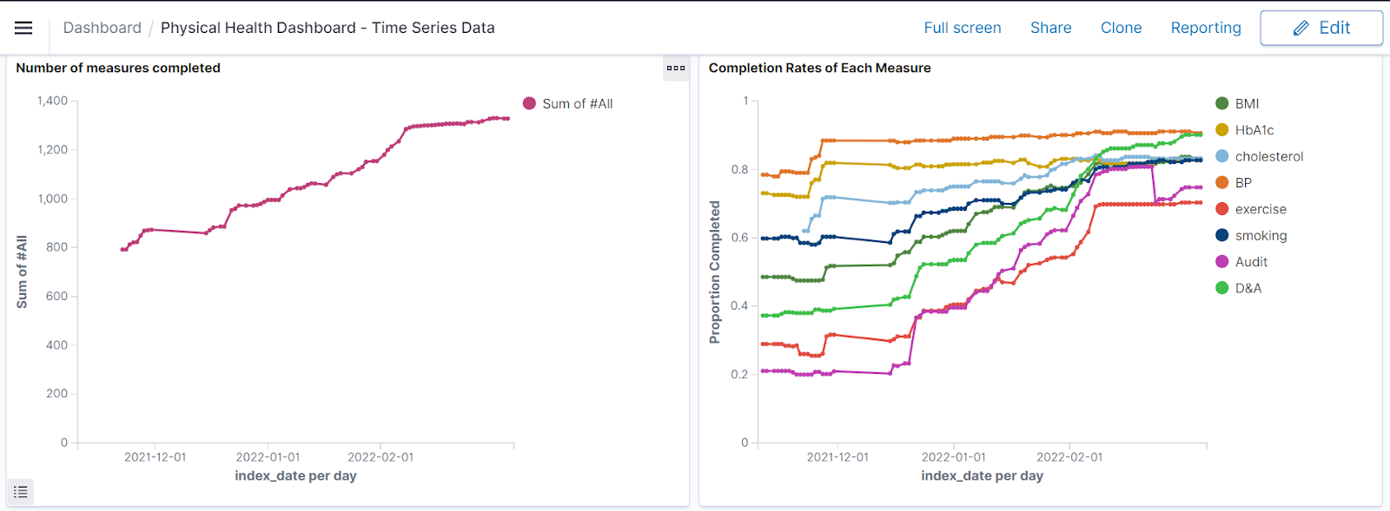
e.g. Impact on care: improved physical health monitoring

Slide 31
CRIS papers per year (estimated)
https://www.maudsleybrc.nihr.ac.uk/facilities/clinical-record-interactive-search-cris/cris-publications/

Slide 32
CRIS Acknowledgements - a multi-disciplinary team
Leads
Matthew Broadbent, Richard Dobson, Stuart MacLellan, Rob Stewart
Administration / management
Debbie Cummings, Amelia Jewell, Daisy Kornblum
Technical team
Lara Brooks-Simpson (data linkage), Pampa Chakravarti (clinical informatics service), Risha Govind (clinical informatics service), Shanmukha Gudiseva, Satyendra Katneni (database administration), Hitesh Shetty (data extraction), Jyoti Sanyal (NLP support)
Epidemiology / Clinical
David Codling, Johnny Downs, Rina Dutta, Sophie Epstein, Richard Hayes, Giouliana Kadra, Ruimin Ma, Christoph Mueller, Rashmi Patel, Gayan Perera, Kate Polling, Eugenia Romano, Brendon Stubbs
Bioinformatics / Computer Science / NLP
Craig Colling, David Chandran, Zina Ibrahim, Zeljko Kraljevic, Lifang Li, Yamiko Msosa, Angus Roberts, Tao Wang, Lukasz Zalewski
PhD studentships
Norah Alothman, Nikeysha Bell, Delia Bishara, Jaya Chaturvedi, Natasha Chilman, Katrina Davies, Emel Yorganci
Oversight and Governance
Christina Armoogum, Eva Broeckelmann, Claire Delaney-Pope, Patrick Green
SLAM partners
Barbara Arroyo, Fiona Gaughran, Justin Sauer, David Taylor
University of Sheffield (Computer Science) collaborators
Kalina Bontcheva, Ian Roberts

Slide 33
Thank you
angus.roberts@kcl.ac.uk https://www.kcl.ac.uk/people/angus-roberts

